Slide 1

English 7 Tue, Sept 12th, 2017
UNIT 2 . HEALTH
PERIOD 12: LESSON 4. COMMUNICATION
Welcome to our class
Teacher: Nguyen Thi Thu Ha

Slide 2


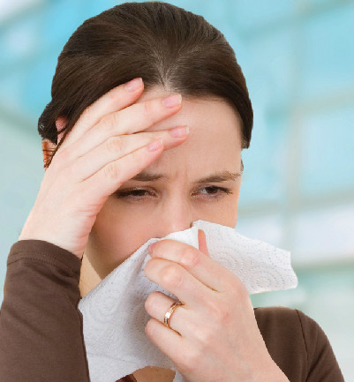
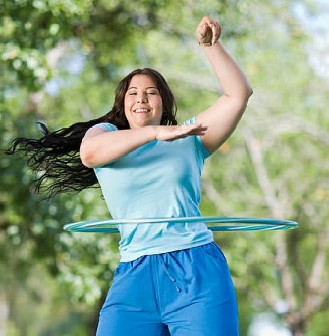
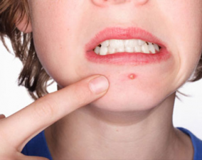
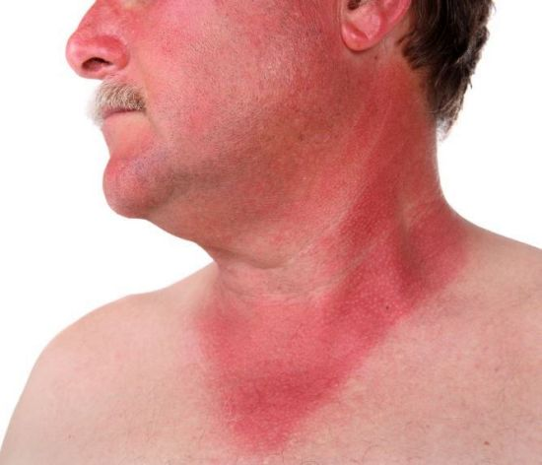
Look and write the names of the health problems
(an) allergy
sickness
flu
1. ……………….
2. ………………….
3. …………………
(put on) weight
4
sunburn
spots
5. ………………….
6. ………………

Slide 3

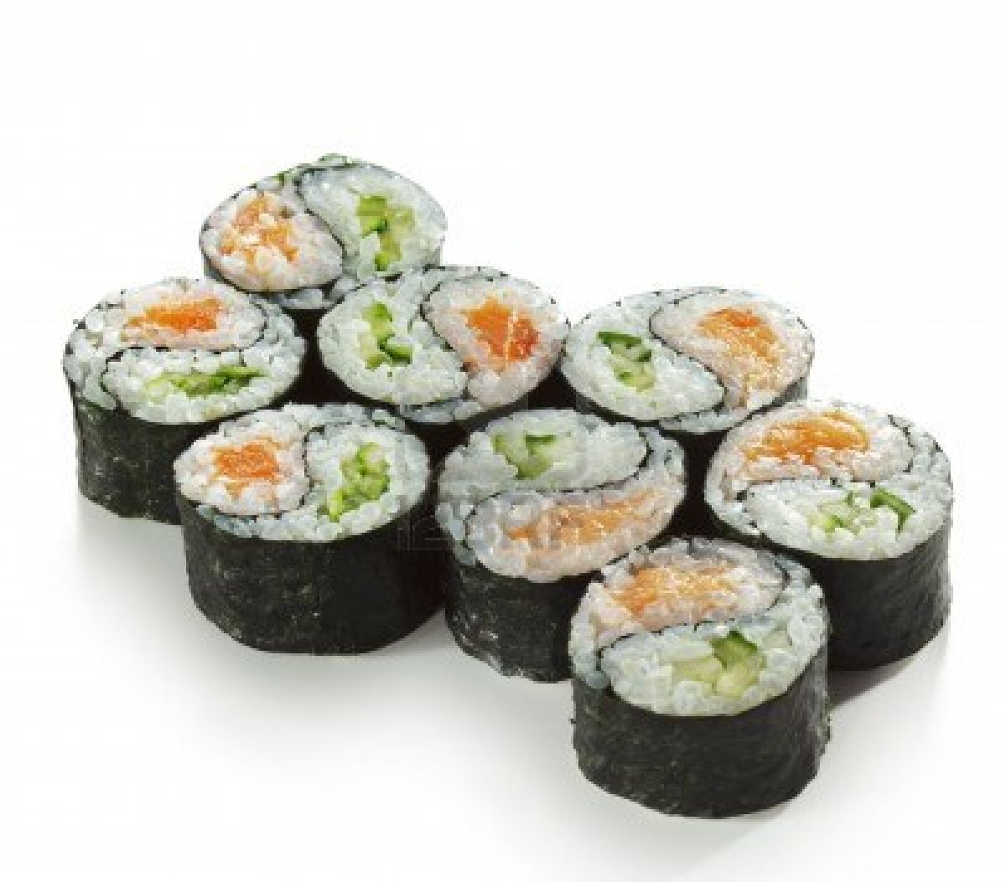


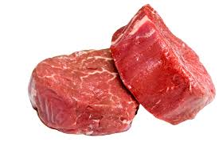
I. New words
NO

Slide 4
I. New words:
myth / mɪθ / (n): huyền thoại, việc hoang đường
sushi / ˈsuːʃi / (n): su- si
vitamin / ˈvɪtəmɪn / (n): vitamin
sleeping in /ˈsliːpɪŋ ɪn/ (n): ngủ nhiều, ngủ nướng
vegetarian /ˌvedʒɪˈteərɪən / (n): người ăn chay

Slide 5
Checking vocabulary:
sushi/ˈsuːʃi/ (n) việc hoang đường
vitamins/ˈvɪtəmɪnz /(n) người ăn chay
sleep in/sliːp ɪn/ vi-ta-min
vegetarian/ˌvedʒɪˈteərɪən/(n) ngủ nướng
myth / mɪθ/ (n) cơm cuộn

Slide 6

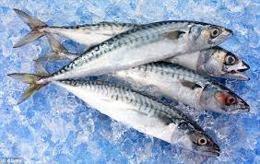

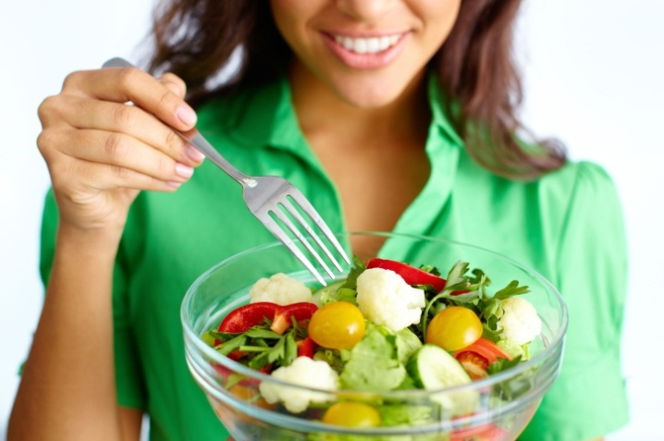
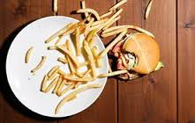
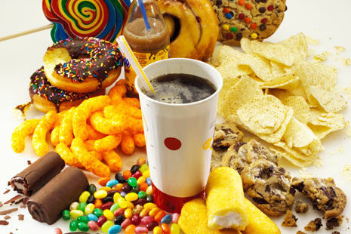
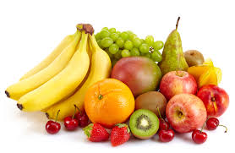

II. Practice
Task 1. Work in groups.
Discuss & write F (fact) or M (myth) for each statement
HEALTH FACTS OR MYTHS?
1. People who smile more are happier, and they live longer
2. Sleeping in at the weekend helps you recover from a busy week
3. Eat more fresh fish, like sushi, and you will be healthier
4. Sitting too close to the TV hurts your eyes
5. Pick up food you drop quickly, and it’s safe to eat
6. Vegetarians don’t get enough vitamins in their food

Slide 7

II. Practice
Task 2. Listen to the radio show about “health facts or myths”
& check your answer in 1
HEALTH FACTS OR MYTHS?
1. People who smile more are happier, and they live longer
2. Sleeping in at the weekend helps you recover from a busy week
3. Eat more fresh fish, like sushi, and you will be healthier
4. Sitting too close to the TV hurts your eyes
5. Pick up food you drop quickly, and it’s safe to eat
6. Vegetarians don’t get enough vitamins in their food
F
M
F
F
M
M

Slide 8
Tape script
A: So, can we smile more to live longer?
B: Yes, that’s absolutely true.
A: Does sleeping in help you recover?
B: No, false. Waking up at the same time is better.
A: Should we eat more fresh fish, like sushi?
B: No. Sushi is great. But we shouldn’t eat too much.
A: And sitting too close to the TV?
B: No, it’s not how close you sit. It’s how long you watch TV for.
A: How about picking up food we drop. Is it ok?
B: No, that’s a myth! You shouldn’t eat it, ever!
A: OK, last one. Do vegetarians get less vitamins?
B: No, that’s false. You don’t need meat to get your vitamins.

Slide 9
3. Discuss the following in groups.
1. Which sentence are you most surprised by? Why?
The sentence “No, it`s not how close you sit. It`s how long you watch TV for” makes me most surprised because my parents always say “Don’t sit too close to the TV. It hurts your eyes!” 2. Do you know any health facts in Vietnam?
Chicken soup is a good remedy for a cold. Tea is better for your health than coffee. Stress or lack of sleep causes pimples (spots), not because of chocolate. It is butter we put to bread and potatoes that makes us put on weight not bread and potatoes which are not fattening. Laughter is the best medicine.

Slide 10
II. Practice
Task 3. Work in groups
Think of some sentences about health that are true & false
Facts | Myths
Eat less fast food, and it’s good for health To prevent flu, we must eat a lot of garlic. To stay healthy, We should eat more fruit and vegetables A lack of exercise is now causing as many deaths as smoking across the world. It is possible to go blind from smoking too heavily. Sleeping less than 7 hours each night reduces your life expectancy. Right-handed people live, on average, nine years longer than left-handed people. | Swallowed seed they will grow in your stomach . Eggs are bad for your heart Going in the rain is very safe. - Calories eaten at night are more fattening than those eaten early in the day. - Radiation from microwaves creates dangerous compounds in your food. - Being cold gives you a cold. - Cracking joints causes arthritis

Slide 11
II. Practice
Task 4. Work in groups. Put the phrases in correct column.
Why do the Japanese people live so long?
have a moderate diet drink less water drink tea often
drink coke do less activities eat more fast food
do exercise regularly watch too much TV eat less
eat less red meat do yoga eat a lot of junk food
Do | Don’t
have a moderate diet
drink less water
drink tea often
do exercise regularly
eat less red meat
do yoga
eat a lot of junk food
drink coke, eat less
do less activities
eat more fast food
watch too much TV

Slide 12

III. Homework
Write 5 Vietnamese health tips to have a long lifespan
Review the lesson
Prepare for the coming lesson

Slide 13


